Slide 1
Finding Bugs in P4 Compilers
Fabian Ruffy, Tao Wang, and Anirudh Sivaraman
https://github.com/p4gauntlet/gauntlet

Slide 2
What this talk is about
How to find bugs in compilers for the P4 language
How to combine fuzzing and formal methods to find bugs
Gauntlet, our tool suite that finds bugs in P4 compilers
Results and Future Work

Slide 3
What is P4?
High-level programming language for network data planes
Allows for protocol flexibility
Specifies a packet processing pipeline
Compiled and loaded into target platform
Open and standardized
P4: Programming Protocol-Independent Packet Processors
Pat Bosshart, Dan Daly, Glen Gibb, Martin Izzard, Nick McKeown, Jennifer Rexford, Cole Schlesinger, Dan Talayco, Amin Vahdat, George Varghese, David Walker ACM SIGCOMM Computer Communications Review (CCR). Volume 44, Issue #3 (July 2014)

Slide 4
P4: Current Landscape
Language has reached a stable state with P4₁₆
Increasingly adopted by commercial enterprises
Back ends: Barefoot Tofino, Cisco Silicone One, Xilinx Netcope P4, …
Users: Google, Broadcom, Nokia, Orange, Princeton…
P4₁₆ has a reference compiler: P4C
Has status similar to LLVM/GCC; represents the language specification
Users convert the generated IR to their target instruction set
P4C transforms input → streamlines code and includes code quality passes

Slide 5
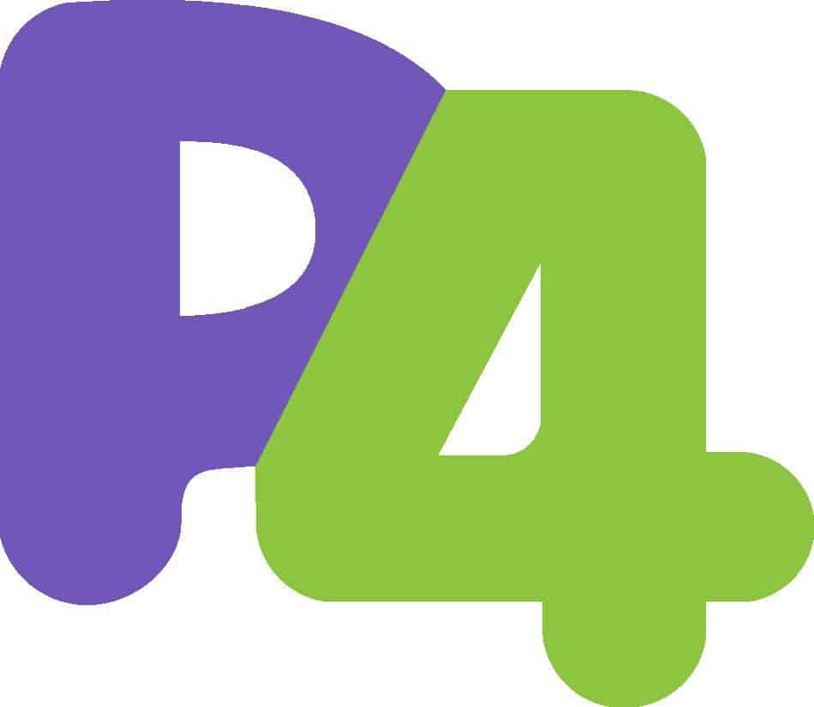
Compiler Context: P4C
IR with target-specific
extensions
Same IR
P4 Program
P4₁₆
Parser
Front End
Mid End
Back End
IR
IR
IR
Target-independent nanopasses
(25+ distinct transformations)
Target-specific nanopasses
IR: Intermediate Representation
Nanopass: Small program transformation using IR

Slide 6
Do We Know if P4C Compiles Correctly?
Data plane equipment is part of core infrastructure
High impact of erroneous compilation
Faulty packet processing hard to detect
Prior research shows that GCC/LLVM had hundreds of subtle bugs
P4C certainly no exception
How can we ensure that P4 compilers are reliable?

Slide 7
Stages of Testing a Compiler
Level
Input Class
Adversarial Test Example
Available P4 Tools
Increased Precision
1
Sequence of ASCII characters
Random bit stream
Sequence of words, etc.
Non-alphanumeric names
American Fuzzy Lop (AFL)
P4Fuzzer
2
3
Syntactically correct program
Missing brackets
4
Type-correct program
Adding int to a header
5
Statically conforming program
Exit within a function
Random program generation
combined with semantics
(our work)
6
Dynamically conforming program
Header Initialization
7
Model-conforming program
Input that leads to wrong output
Differential testing for software. , McKeeman, William M., Digital Technical Journal 10.1 (1998): 100-107.

Slide 8
Two Types of Bugs
Sequence of ASCII characters
Sequence of words, white space…
Syntactically correct program
Type-correct program
Statically conforming program
Crash Bug
“Obvious” bug
Program input causes the compiler to terminate abnormally
All bugs up to level 5
Miscompilation or “Semantic Bug”
No error raised, but behavior of program is altered
Typically caused by misbehaving compiler passes
Level 6 and above
Dynamically conforming program
Model-conforming program

Slide 9
How to Find Crash Bugs in P4?
Sequence of ASCII characters
Sequence of words, white space…
Syntactically correct program
Type-correct program
Statically conforming program
We target level 5
P4 compilers mature enough to handle 1-3
Generate random programs that are valid
Identify programs that cause a non-zero exit code
May be a crash, out-of-memory error, or timeout
Could also be a program that is incorrectly rejected
We can also use the random programs for finding semantic bugs
Dynamically conforming program
Model-conforming program

Slide 10
How to Find Semantic Bugs in P4?
Sequence of ASCII characters
Sequence of words, white space…
Syntactically correct program
Type-correct program
Statically conforming program
Compiler Verification?
Complete but costly and inflexible
Need to write proofs for every new target architecture
Differential testing?
Cannot compare outputs across different target backends
P4 too young to have multiple compilers for a single target
Translation validation?
Only requires semantics, no manual proofs or multiple compilers
Difficult to fully implement, but P4’s restrictions make it a good fit
Dynamically conforming program
Model-conforming program

Slide 11
Why Translation Validation for P4?
Traditionally limited because of undecidability
However, P4’s language properties are a great fit for formal methods
Language core not Turing-complete
Bounded loops, static allocation, no arbitrary code execution…
Pipeline-structure provides well-defined state
All output variables known at the beginning of the function
Possible to track and return fixed program state
We can compare entire programs!

Slide 12
The Gauntlet Framework
Toolbox of testing software
Random code generator
P4₁₆ semantic interpreter
Translation validation and testing pipeline
Three concrete techniques to find bugs
Random code generation to find crash bugs
Translation validation to identify miscompilations
Model-based testing for closed-source compilers
Use semantics to infer packet input and expected output
Generate packets that trigger different program paths

Slide 13
P4: Semantic Representation
Use the Z3 SMT solver for formal methods
P4 programs are represented as Z3 SMT-LIB2 formulas
Input/output of the program is modelled as Z3py bit vector datatype
Final expression: datatype of if-then-else expressions
Add branches per table or conditional in the program
Large portions of the language implemented and tested

Slide 14
Normalized Z3 Semantics: Example
P4 Program
Semantic Representation
struct Hdr {bit<8> a; bit<8> b;}
control ingress(inout Hdr hdr) {
action assign() { hdr.a = 1; }
table t {
key = hdr.a : exact;
actions = { assign(); NoAction(); }
default_action = NoAction();
}
main {
t.apply();
}
}
Symbolic input: t_key, t_action, hdr
Symbolic output: hdr_out
hdr_out = if (hdr.a == t_key):
if (1 = t_action):
Hdr(1, hdr.b)
otherwise:
Hdr(hdr.a, hdr.b)
otherwise:
Hdr(hdr.a, hdr.b)

Slide 15
The P4-to-Z3 Interpreter
Extension to the P4 compiler
Uses IR generated by P4Parser to generate Z3 expressions
Target-independent
Only needs P4 model to produce semantics for a P4 program
Designed to handle all forms of the P4 language
Whatever the parser accepts is transformed to Z3
P4 program is converted into a normalized form
Extensively tested
650 P4-16 tests + ~100 custom tests

Slide 16
Technique 1: Bludgeon
Program generator modelled after Csmith
But does not avoid undefined behavior → Simpler
P4C extension that uses P4C IR to generate expressions
“Grows” the AST by randomly picking from available IR expressions
Code generation is guided according to P4₁₆ specification
A correctly rejected, generated program is a bug in Bludgeon
Small fragments of the language sufficient to detect bugs
Branching is limited → State-space explosion not a concern

Slide 17
Bludgeon – Design Details
Each back end is a template that defines…
…what declarations to produce
…which program pipe (ingress, parser…) to fill with random code
Configuration based on global probabilities
Back ends set probabilities of unsupported constructs to zero
Back ends: v1model (simple switch), tna (tofino 1), psa
Usage:
p4c/build/p4bludgeon --output out.p4 --arch tna

Slide 18
Technique 2: Gauntlet Validation
P4C
Generate
Compile
Non-zero exit code
P4 program
Crash bug
Bludgeon
Emit IR
pass1.p4
Pass_1.p4
Pass_1.p4
IR passes
Pass_1.p4
Gauntlet
interpreter
Yes
Unstable
code
…
OK
Equivalent?
Equivalent?
Equivalent?
No
Caused by
undefined behavior?
No
Validation
bug

Slide 19
Gauntlet Validation - Details
Requires full access to the IR of the compiler
Parses P4 files emitted by ToP4 visitor
Semantics are a normalized representation of the P4 program
Undefined behavior ”taints“ this representation
Usage
python3 validate_p4_translation.py –-input out.p4

Slide 20
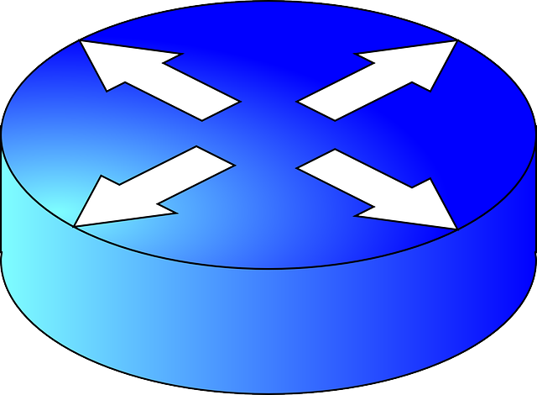
Technique 3: Model-based Testing
Generate
P4C
Compile
Non-zero exit code
P4 program
Crash bug
Bludgeon
Load target
Recorded output
Gauntlet
interpreter
Feed
packets
OK
Generate
test files
test1.stf
Pass_1.p4
Pass_1.p4
Pass_1.p4
Target device
Expected output
Validation bug

Slide 21
Model-based Testing: Details
Requires test framework
Input/output pairs are computed based on branch conditions
Produces STF files for testing
Converts STF to PTF tests for Tofino
Not yet supported:
Insertion of control plane entries
Usage
python3 generate_p4_test.py –-input out.p4

Slide 22
Example of a Real Bug
void assign_eth(inout bit<16> type) {
if (type == 0) {
type = IP6_TYPE;
return;
}
type = IP4_TYPE;
return;
}
control ingress(Header h) {
assign_eth(h.eth.eth_type);
}
void assign_eth(inout bit<16> type) {
if (type == 0) {
;
return;
}
type = IP4_TYPE;
return;
}
control ingress(Header h) {
assign_eth(h.eth.eth_type);
}
Assignment
removed!
DefUse Analysis

Slide 23
Tracked Results
Found 96 compiler bugs in 8 months
62 compiler crashes, 25/62 in the Tofino compiler back end
34 semantic bugs, 7/34 in in the Tofino compiler back end
Resulted in 6 specification changes
Gauntlet is now a part of the continuous integration pipeline of P4C!

Slide 24
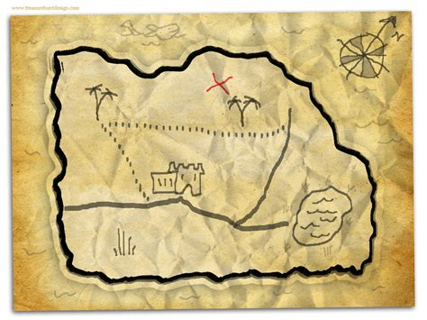
Details: Bug Locations
Front End:
38/96 bugs, exclusively detected in P4C
A lot of type-checking issues
Mid End:
21/96, bugs were largely semantic
More advanced transformations?
Back End:
37/96, primarily in the Tofino compiler
Front- and mid-end bugs also apply to the Tofino compiler

Slide 25
Limitations
The bug-finding techniques require semantics
Bugs in the semantics lead to false positives
Non-programmable blocks not specified
Model-based testing fundamentally limited
Parser semantics not efficient and well tested
Full (single-thread) validation of switch.p4 takes ~5 hours
Semantics are specifically tailored for specification equality checks
Not general, may not capture all safety or functional properties
Cannot identify more than correctness bugs

Slide 26
Future Work and Ideas
Extend translation validation to back ends
Guarantees correctness during the entire compilation process
Requires access to the back end and its IR
Facilitate more aggressive optimizations
Skip compiler optimizations that produce incorrect code
Allows fail-safe experimentation
Find missed optimizations and performance bugs
Identify when an optimization should have been applied
Identify compiler passes negatively affecting performance

Slide 27
Summary on Contributions
P4 random program generator that embraces undefined behavior
Target-independent, symbolic P4 interpreter
Framework that finds miscompilations in P4 programs for…
…every compilation step in the reference compiler
…end-to-end on closed-source P4 compilers
Identified more than 90 bugs within four months of testing
Reported to open-source community and fixed
Also found many bugs in the Tofino compiler
https://github.com/p4gauntlet/gauntlet

Slide 28
BACKUP

Slide 29
Performance Numbers
Program | Architecture | Lines of Code | Time (mm:ss)
tna_simple_switch.p4 | TNA | 1940 | 00:05
switch_tofino_x0.p4 | TNA | 5751 | 00:51
switch_tofino2_y0.p4 | TNA | 6024 | 00:53
fabric.p4 | V1Model | 958 | 00:02
switch.p4 (from P4-14) | V1Model | 5894 | 10:20

